Slide 1
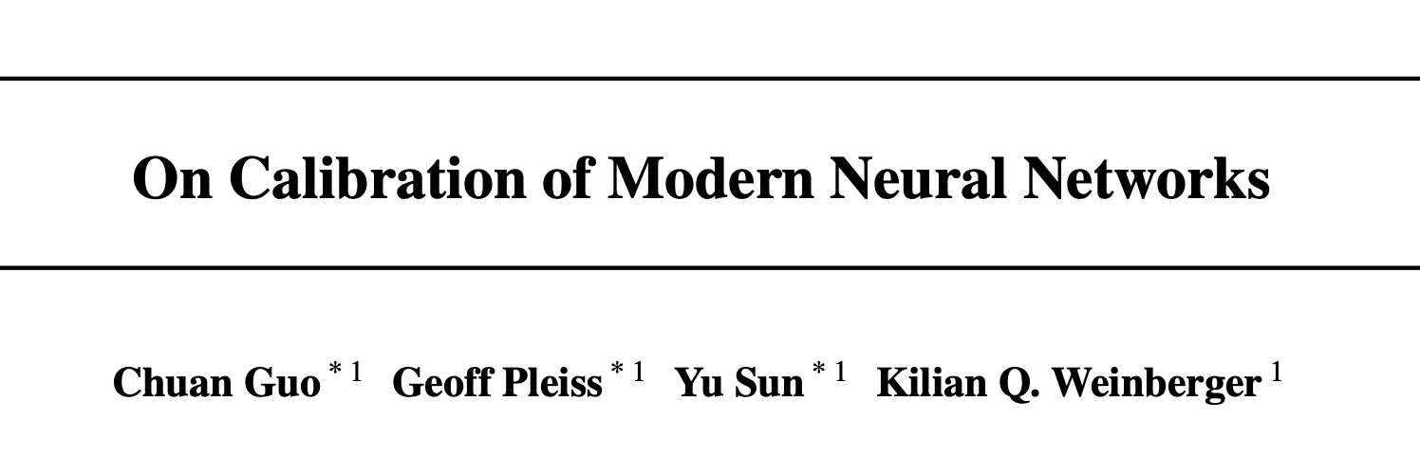
On Calibration of Modern Neural Networks
Presented by Soham Dan

Slide 2
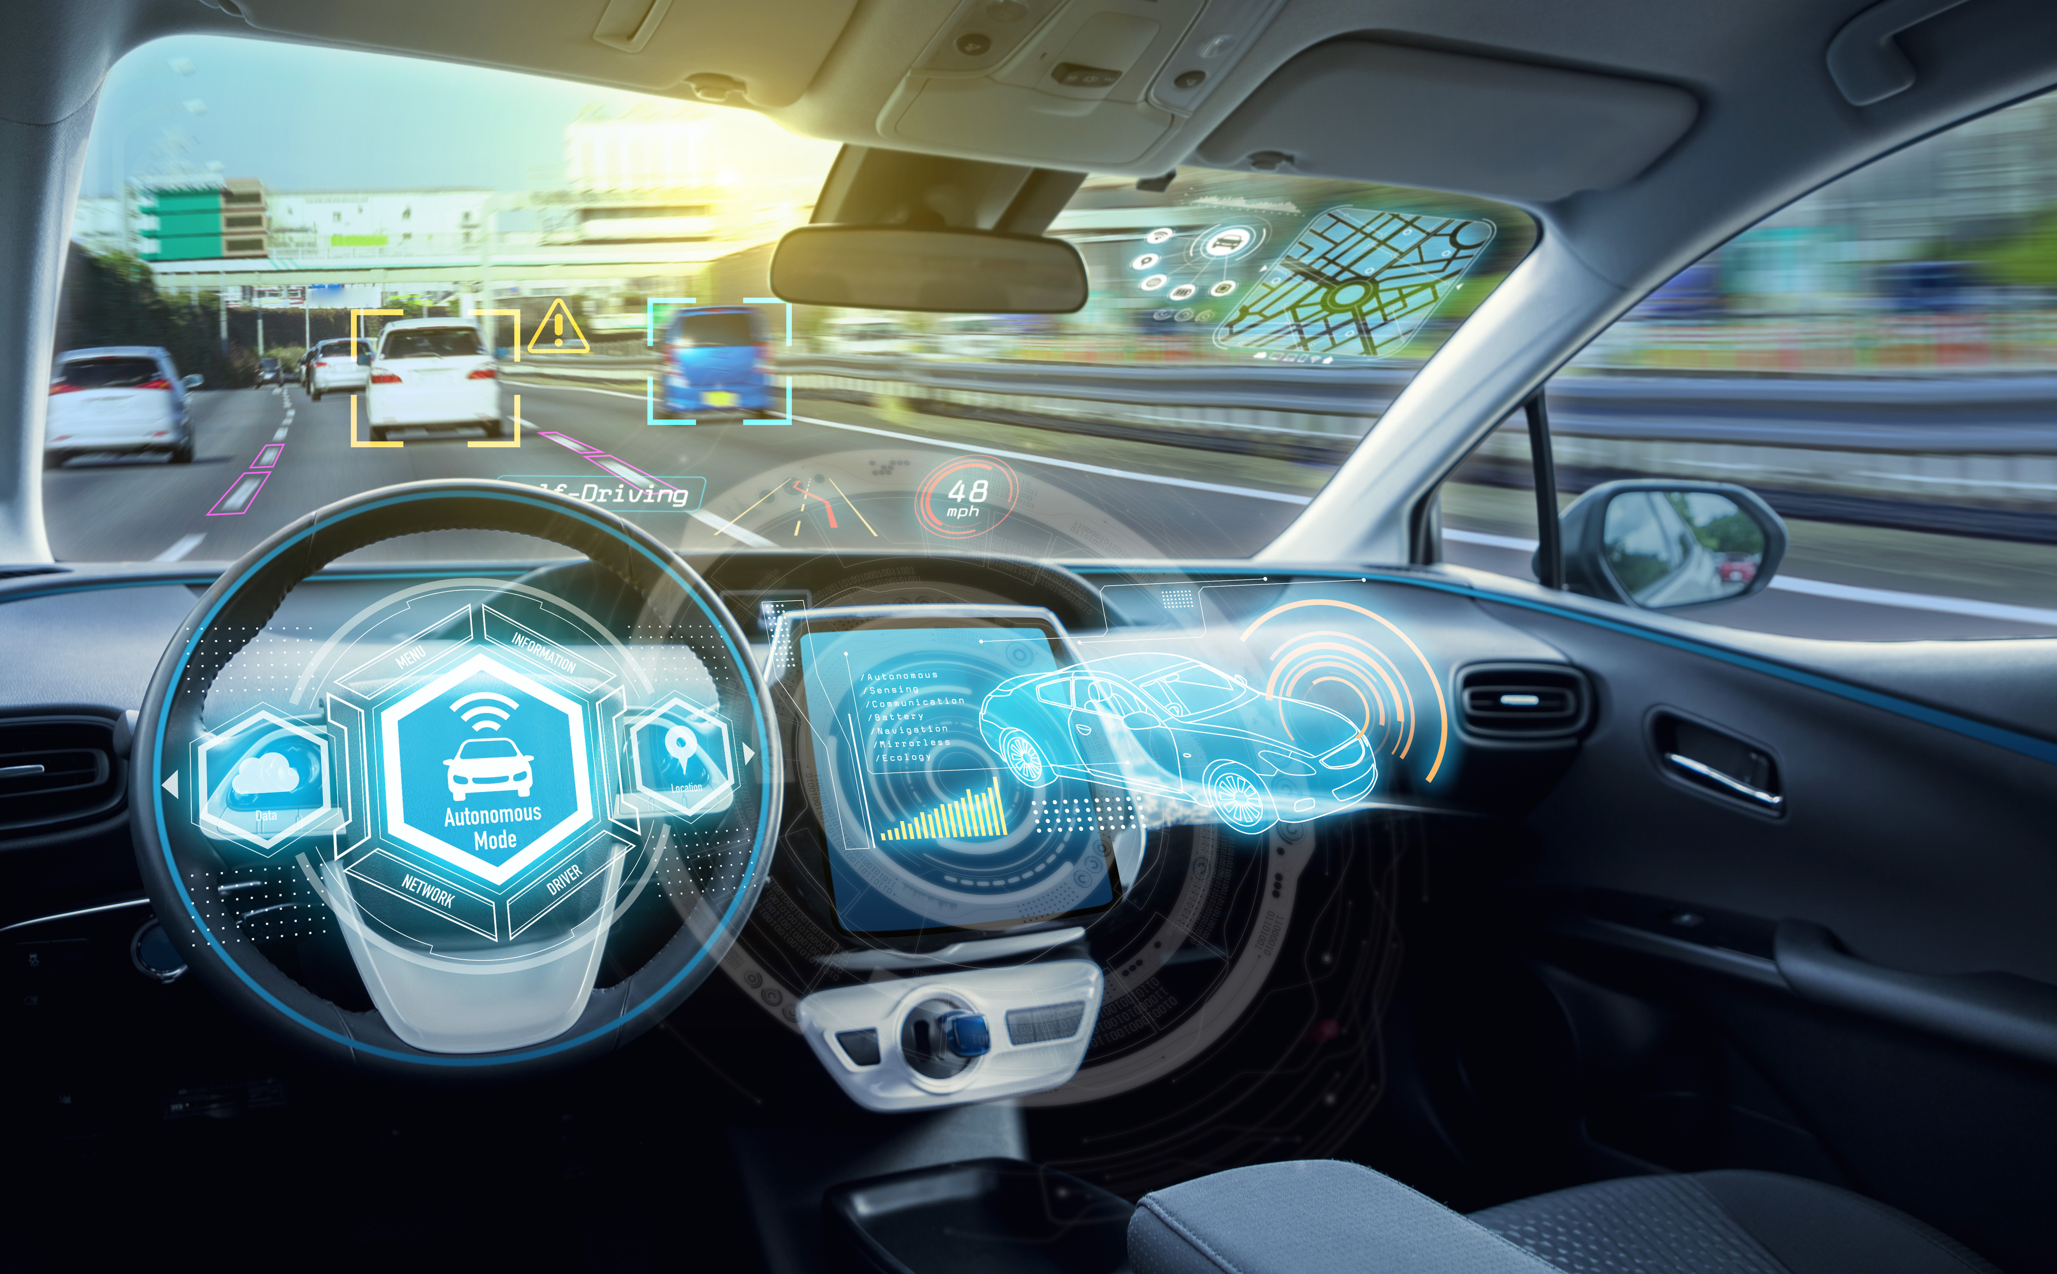
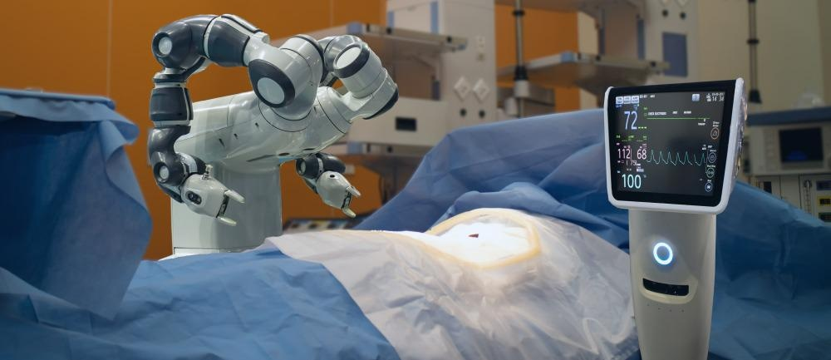
Confidence Calibration is important!
Self Driving Cars
Automated Healthcare
Confidence Calibration:
The probability associated with the predicted class label should reflect its ground truth correctness likelihood.

Slide 3
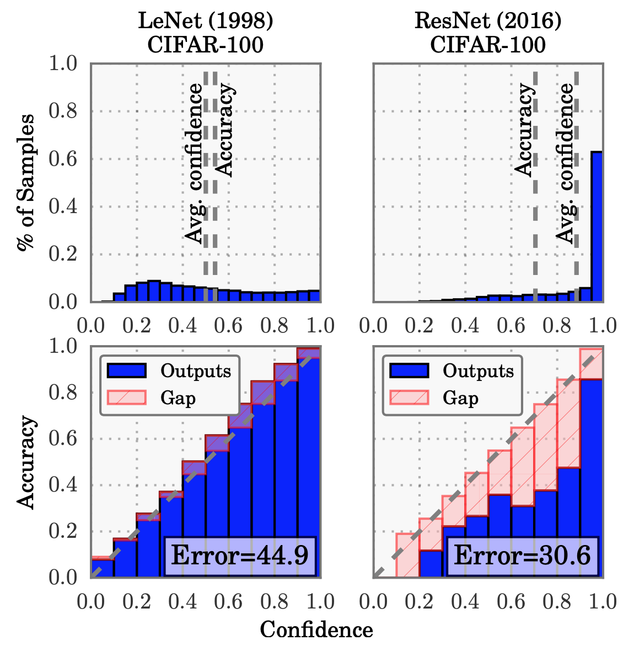
Modern Neural Networks are no longer calibrated
Old neural networks produce well-calibrated probabilities on binary classification tasks. [Niculescu-Mizil & Caruana (2005)]
Modern Neural Networks are much more accurate.
Calibration?

Slide 4
Contents
Definition of Calibration and Metrics.
Calibration of Deep Neural Networks.
Post-Processing Calibration Methods.

Slide 5
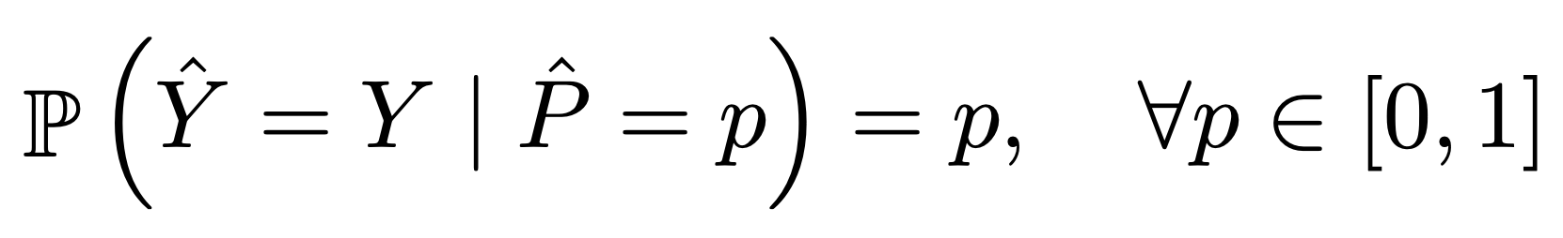
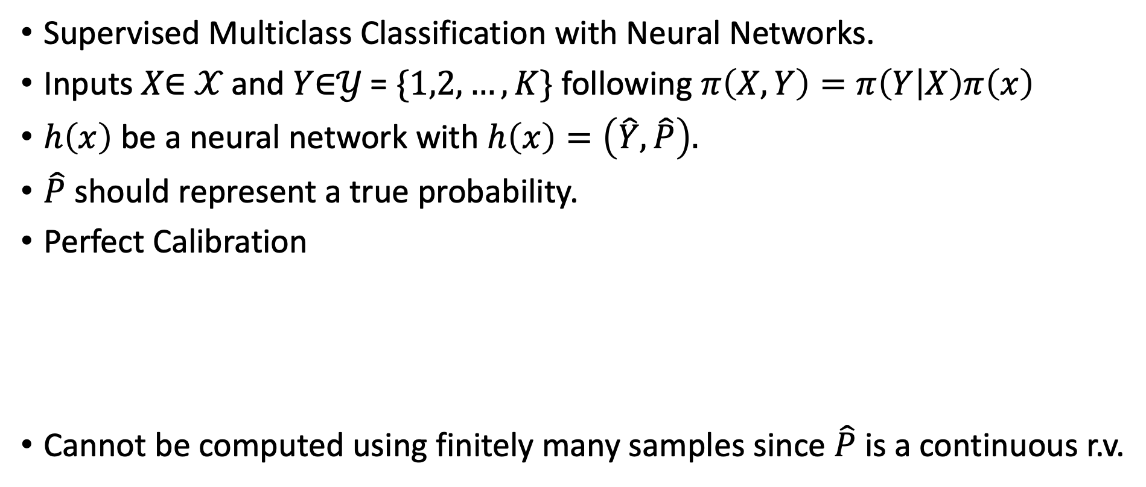
Calibration
Supervised Multiclass Classification with Neural Networks.
Inputs 𝑋$∈$ 𝒳 and 𝑌$∈$𝒴 = $\{1,2,…,K\}$ following $π\left(X,Y\right)=π\left(Y | X\right)π\left(x\right)$
$h\left(x\right)$ be a neural network with $h\left(x\right)=\left(\hat{Y}, \hat{P}\right).$
$\hat{P}$ should represent a true probability.
Perfect Calibration
Cannot be computed using finitely many samples since $\hat{P}$ is a continuous r.v.

Slide 6
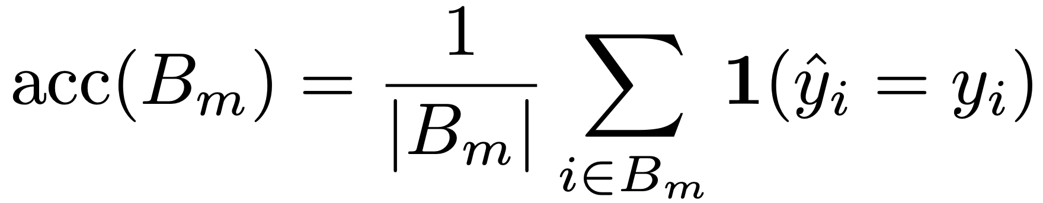
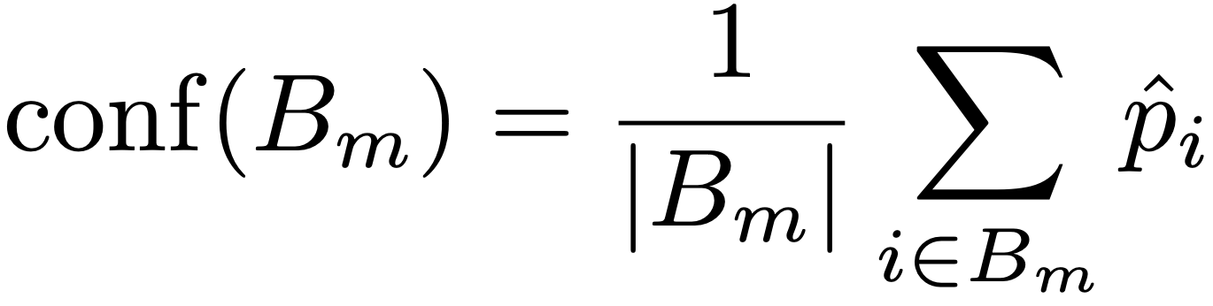
Reliability Diagrams
Plots accuracy as a function of confidence.
For perfect calibration, the diagram plots the identity function.

Slide 7
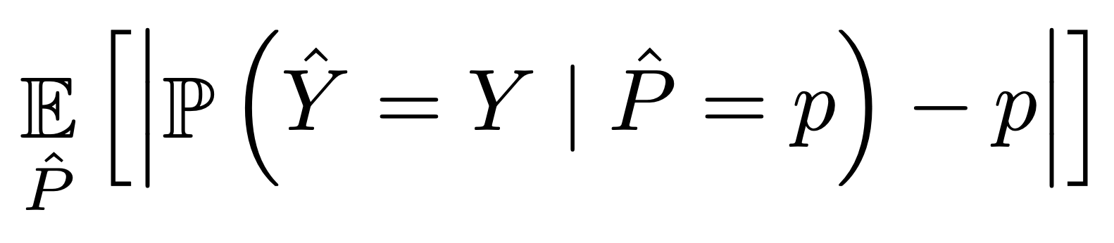
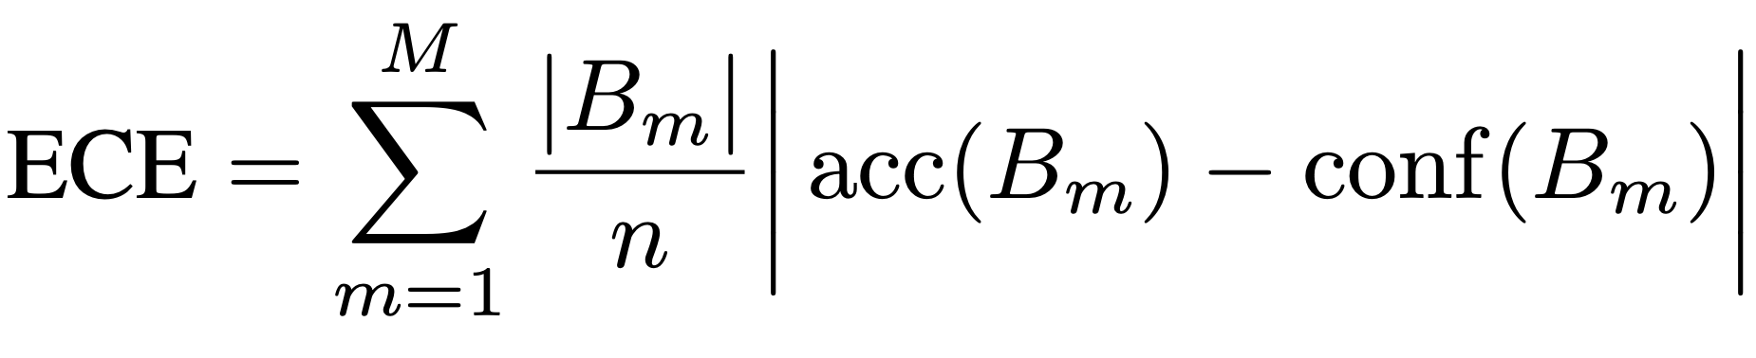
Expected Calibration Error (Naeini et al. (2015))
One notion of miscalibration is the difference in expectation between confidence and accuracy:

Slide 8
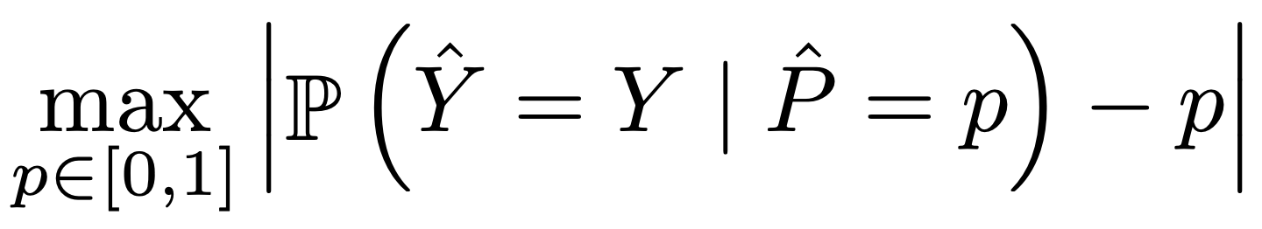
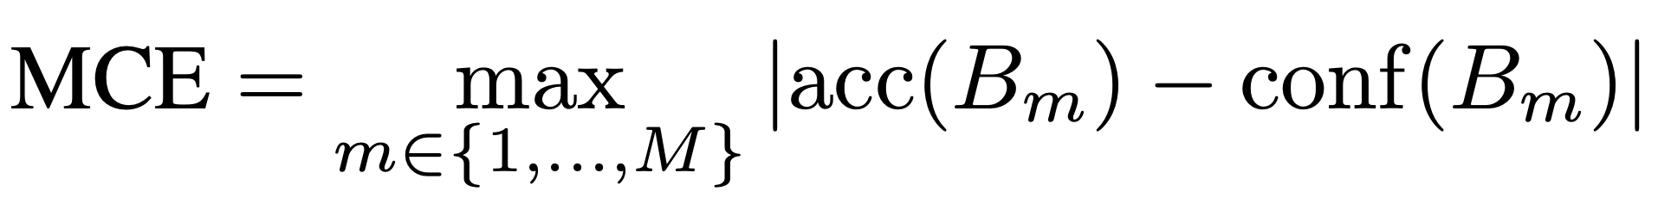
Maximum Calibration Error
Captures worst case deviation between accuracy and confidence.
For perfectly calibrated classifiers, MCE and ECE both equal 0

Slide 9
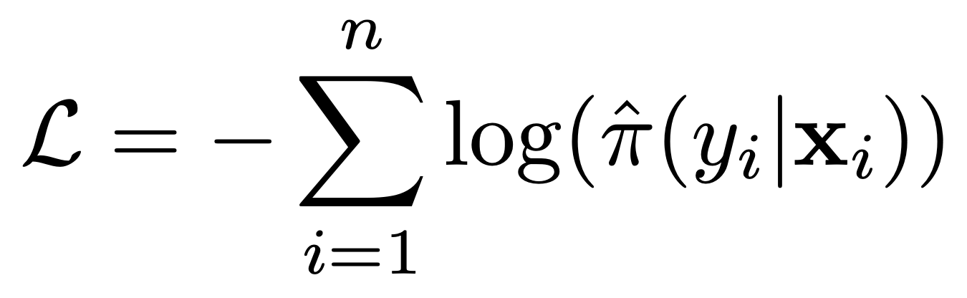
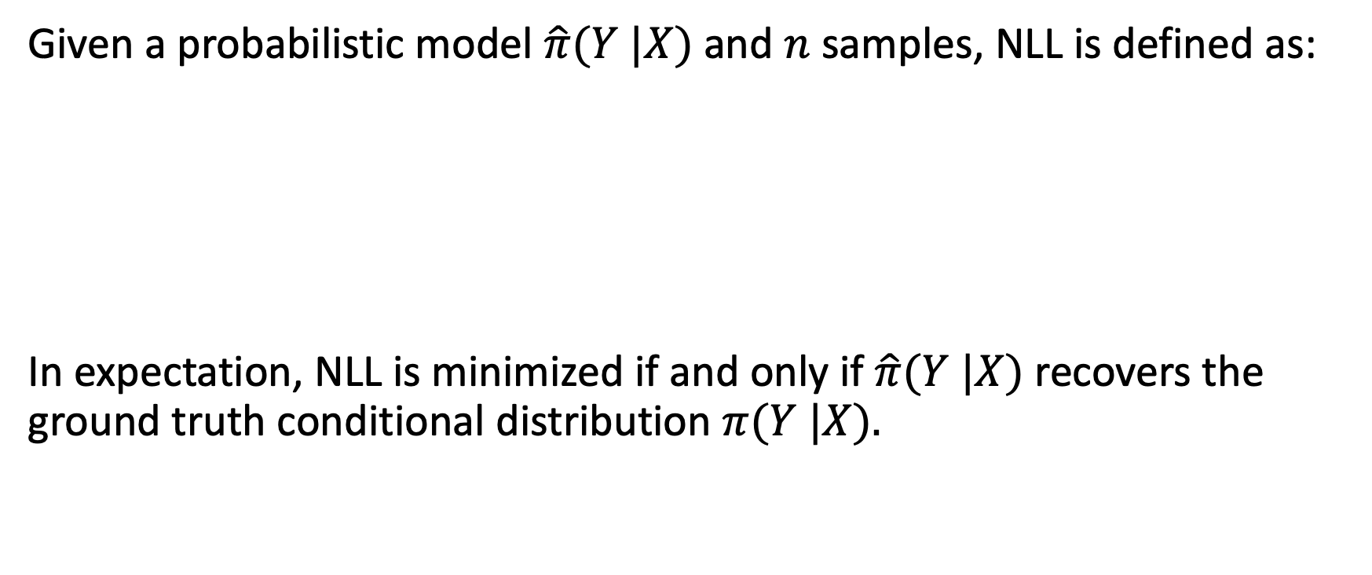
Negative Log Likelihood
Given a probabilistic model $\hat{π}(Y |X)$and $n$samples, NLL is defined as:
In expectation, NLL is minimized if and only if $\hat{π}(Y |X)$recovers the ground truth conditional distribution $π(Y |X).$

Slide 10
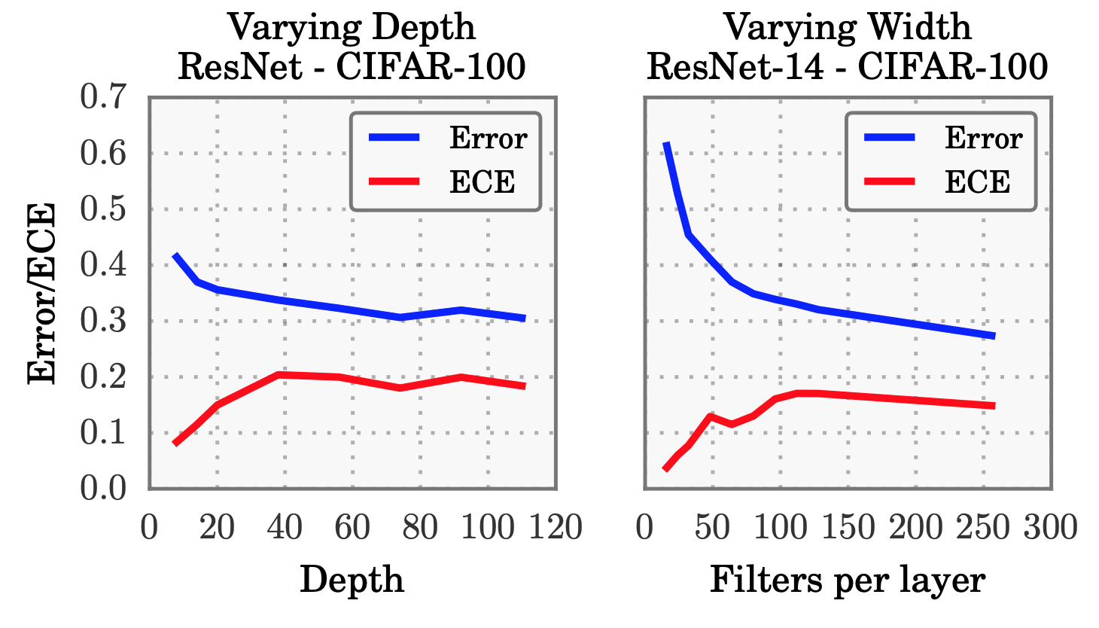
Model Capacity
Increasing depth and width hurt calibration.

Slide 11
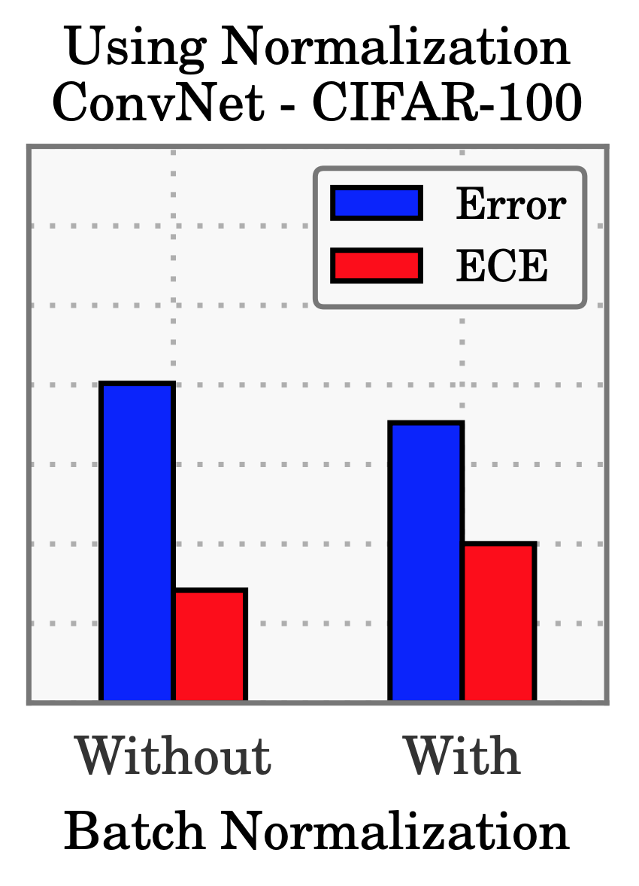
Batch Normalization
Models trained with Batch Normalization are more miscalibrated.
Holds regardless of hyperparameters of BN.

Slide 12
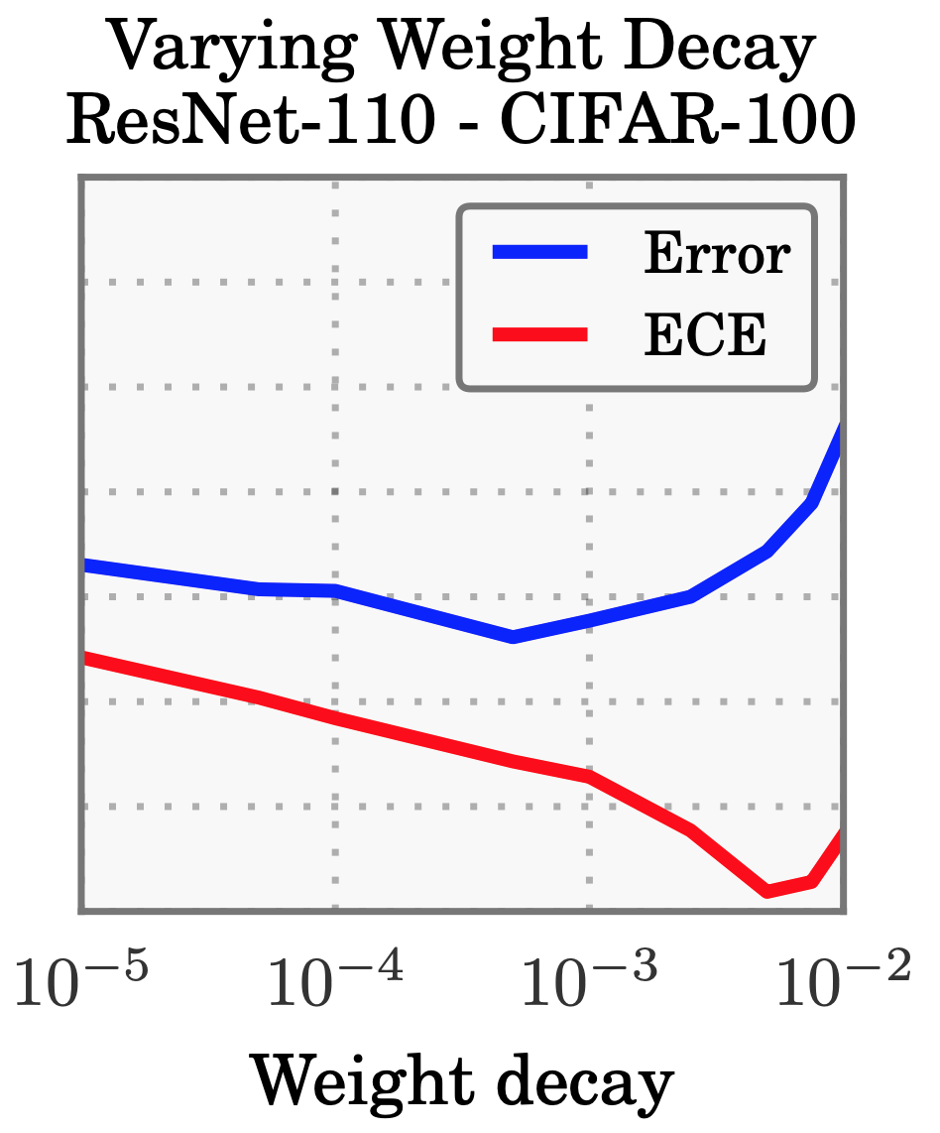
Weight Decay
Regularization using BN has replaced the use of weight decay.
Training with less weight decay has negative impact on calibration.
Accuracy is hurt by too much/ too little weight decay but not calibration.

Slide 13
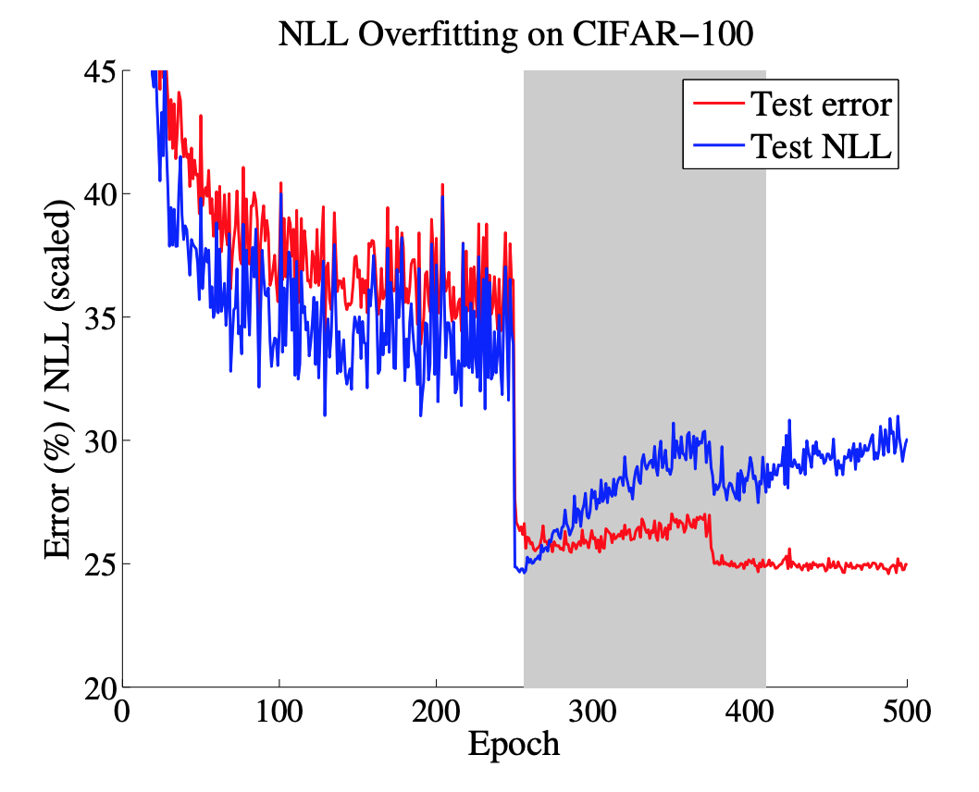
Negative Log Likelihood
Models overfit to NLL without overfitting to 0/1 loss.
Overfitting to NLL actually helps accuracy!
The network learns better classification accuracy at the expense of well-modeled probabilities.

Slide 14
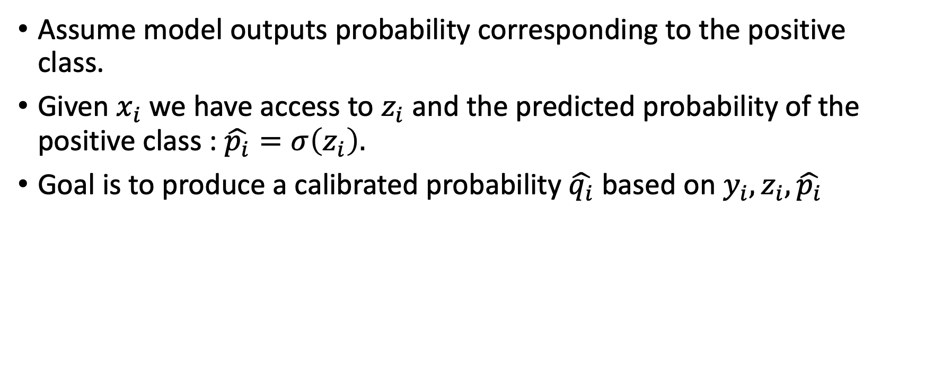
Calibrating Binary Models
Assume model outputs probability corresponding to the positive class.
Given $x_{i}$we have access to $z_{i}$ and the predicted probability of the positive class : $\hat{p_{i}}=σ\left(z_{i}\right).$
Goal is to produce a calibrated probability $\hat{q_{i}}$ based on $y_{i}, z_{i}, \hat{p_{i}}$

Slide 15
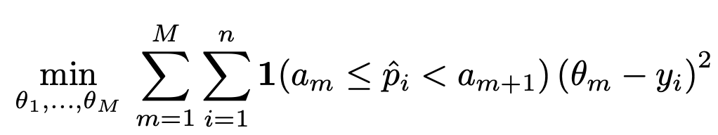
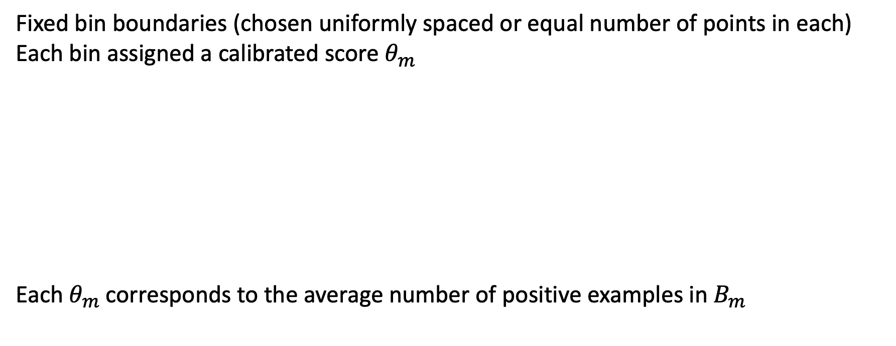
Histogram Binning
Fixed bin boundaries (chosen uniformly spaced or equal number of points in each)
Each bin assigned a calibrated score $θ_{m}$
Each $θ_{m}$corresponds to the average number of positive examples in $B_{m}$

Slide 16
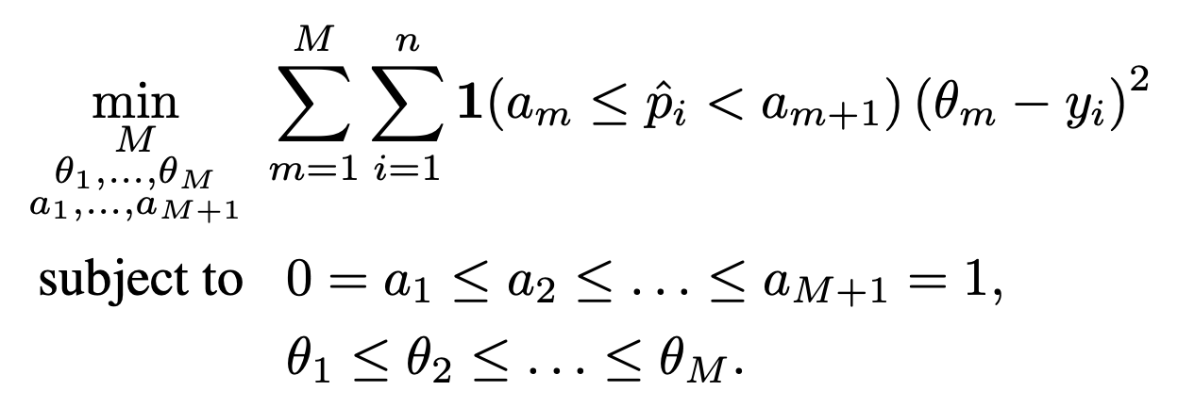
Isotonic Regression
Isotonic regression is a strict generalization of histogram binning in which the bin boundaries and bin predictions are jointly optimized.
Bayesian Binning into Quantiles (BBQ) extends HB and IR using Model Averaging.

Slide 17
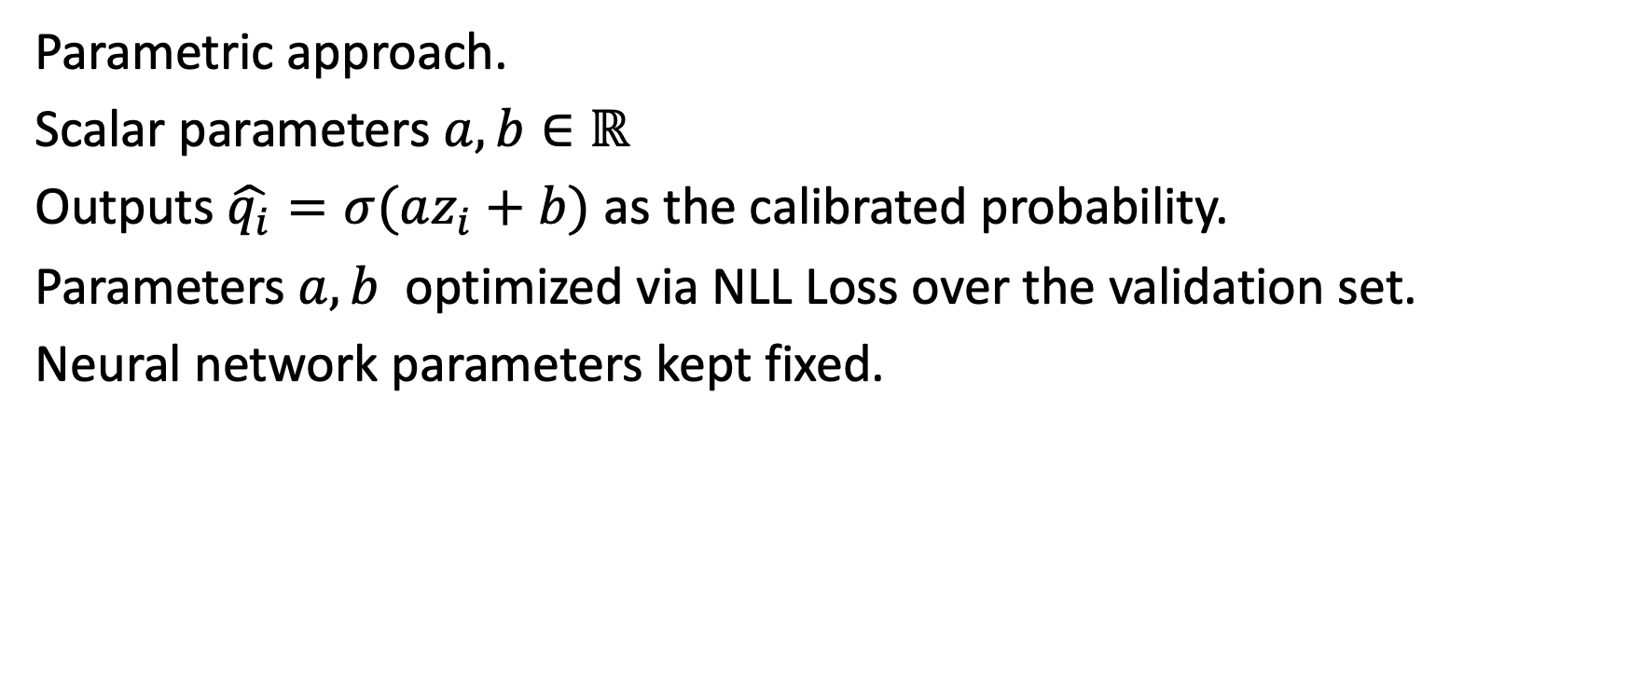
Platt Scaling
Parametric approach.
Scalar parameters $a,b∈ℝ$
Outputs $\hat{q_{i}}=σ(az_{i}+b)$ as the calibrated probability.
Parameters $a,b$ optimized via NLL Loss over the validation set.
Neural network parameters kept fixed.

Slide 18
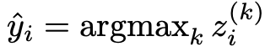
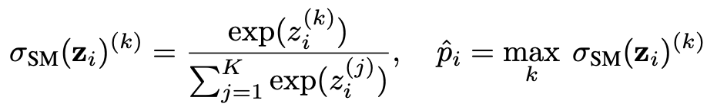
Extension to Multiclass Models

Slide 19
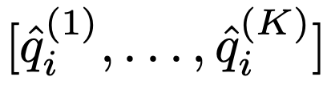
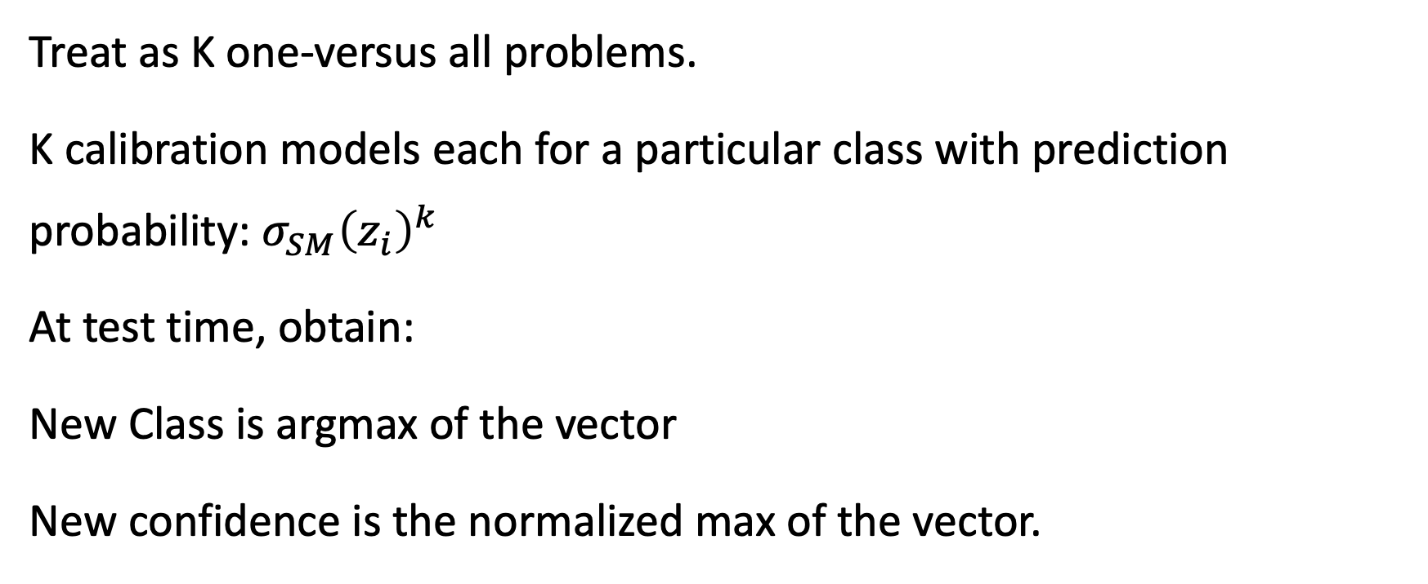
Extension of Binning Methods
Treat as K one-versus all problems.
K calibration models each for a particular class with prediction probability: $σ_{SM}{\left(z_{i}\right)}^{k}$
At test time, obtain:
New Class is argmax of the vector
New confidence is the normalized max of the vector.

Slide 20
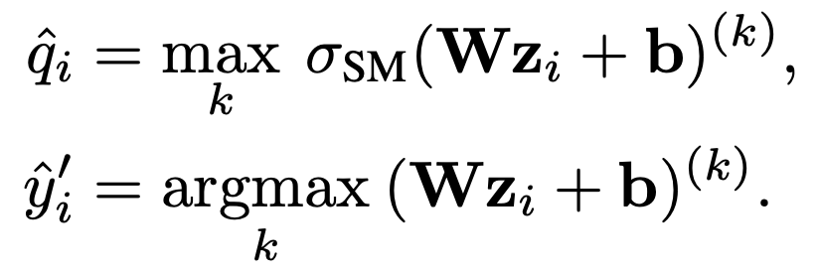
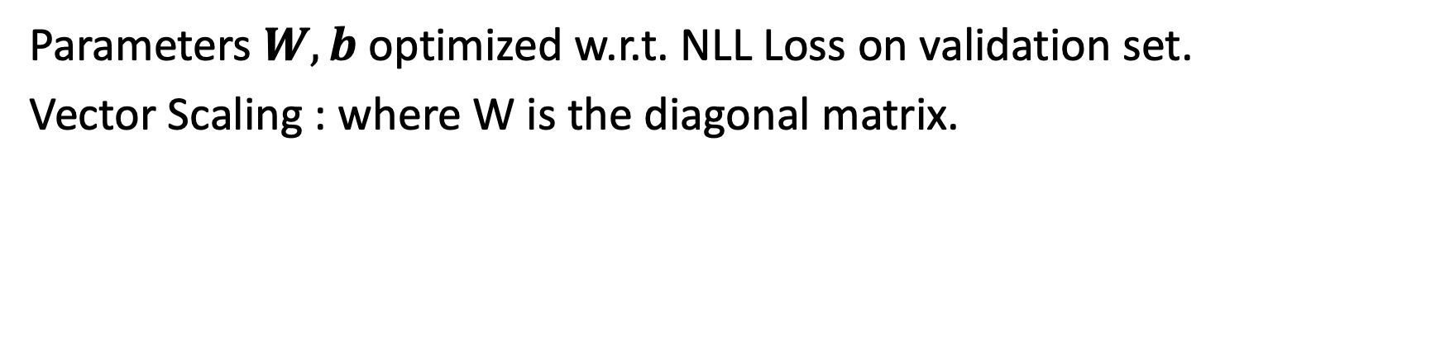
Matrix and Vector Scaling
Parameters $W, b$ optimized w.r.t. NLL Loss on validation set.
Vector Scaling : where W is the diagonal matrix.

Slide 21
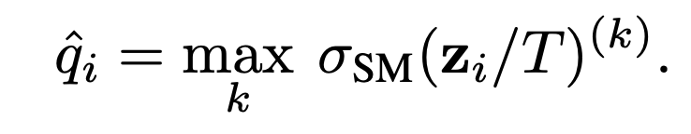
Temperature Scaling
Single parameter T for all the classes
T is optimized with respect to NLL on the validation set.
Temperature scaling does not affect the model’s accuracy.

Slide 22
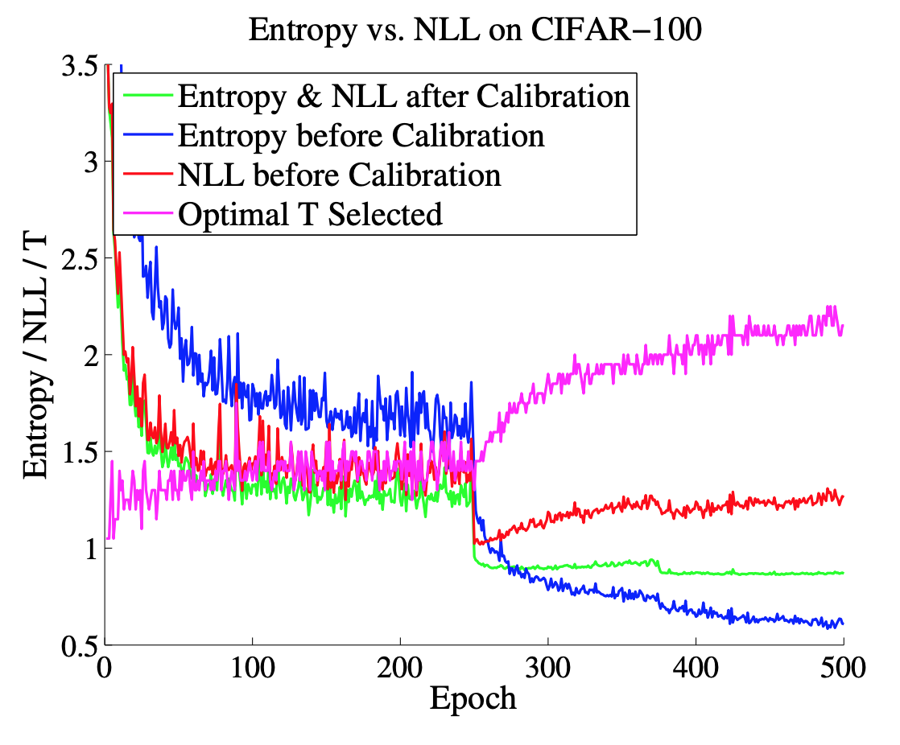
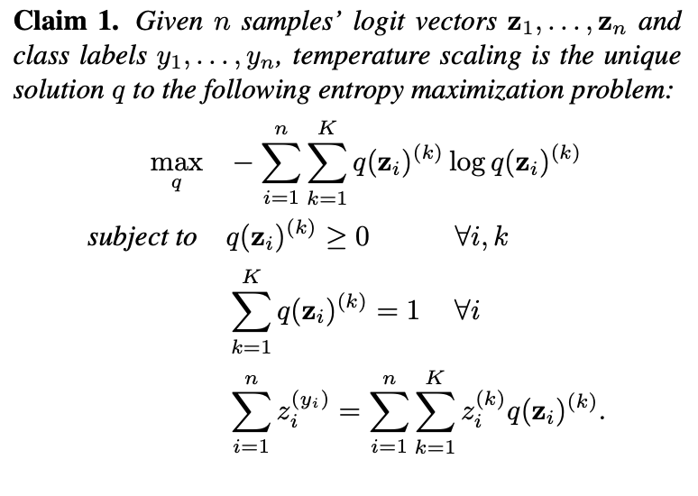
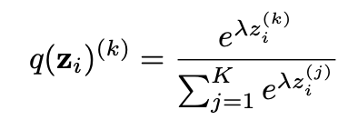
Temperature Scaling

Slide 23
Experiments
20 News: News articles, partitioned into 20 categories by content. 9034/2259/7528 documents for train/validation/test.
Reuters: News articles, partitioned into 8 categories by topic. 4388/1097/2189 documents for train/validation/test.
Stanford Sentiment Treebank (SST): Movie reviews that are annotated by sentiment. Each sample includes a coarse binary label and a fine grained 5-class label. Training/validation/test sets contain 6920/872/1821 documents for binary, and 544/1101/2210 for fine-grained.
Caltech-UCSD : 200 bird species. 5994/2897/2897 images for train/validation/test sets.
Stanford Cars: 196 classes of cars by make, model, and year. 8041/4020/4020 images for train/validation/test.
ImageNet: Natural scene images from 1000 classes. 1.3 million/25,000/25,000 images for train/validation/test.
CIFAR-10/CIFAR-100: Color images (32 × 32) from 10/100 classes. 45,000/5,000/10,000 images for train/validation/test.
Street View House Numbers (SVHN): 32 × 32 colored images of house numbers from Google Street View. 604,388/6,000/26,032 images for train/validation/test.
Models: ResNets, ResNets with Stochastic Depth, Wide ResNets, DenseNets; Networks pre-trained on ImageNet
Models: Deep Averaging Networks, TreeLSTMs

Slide 24
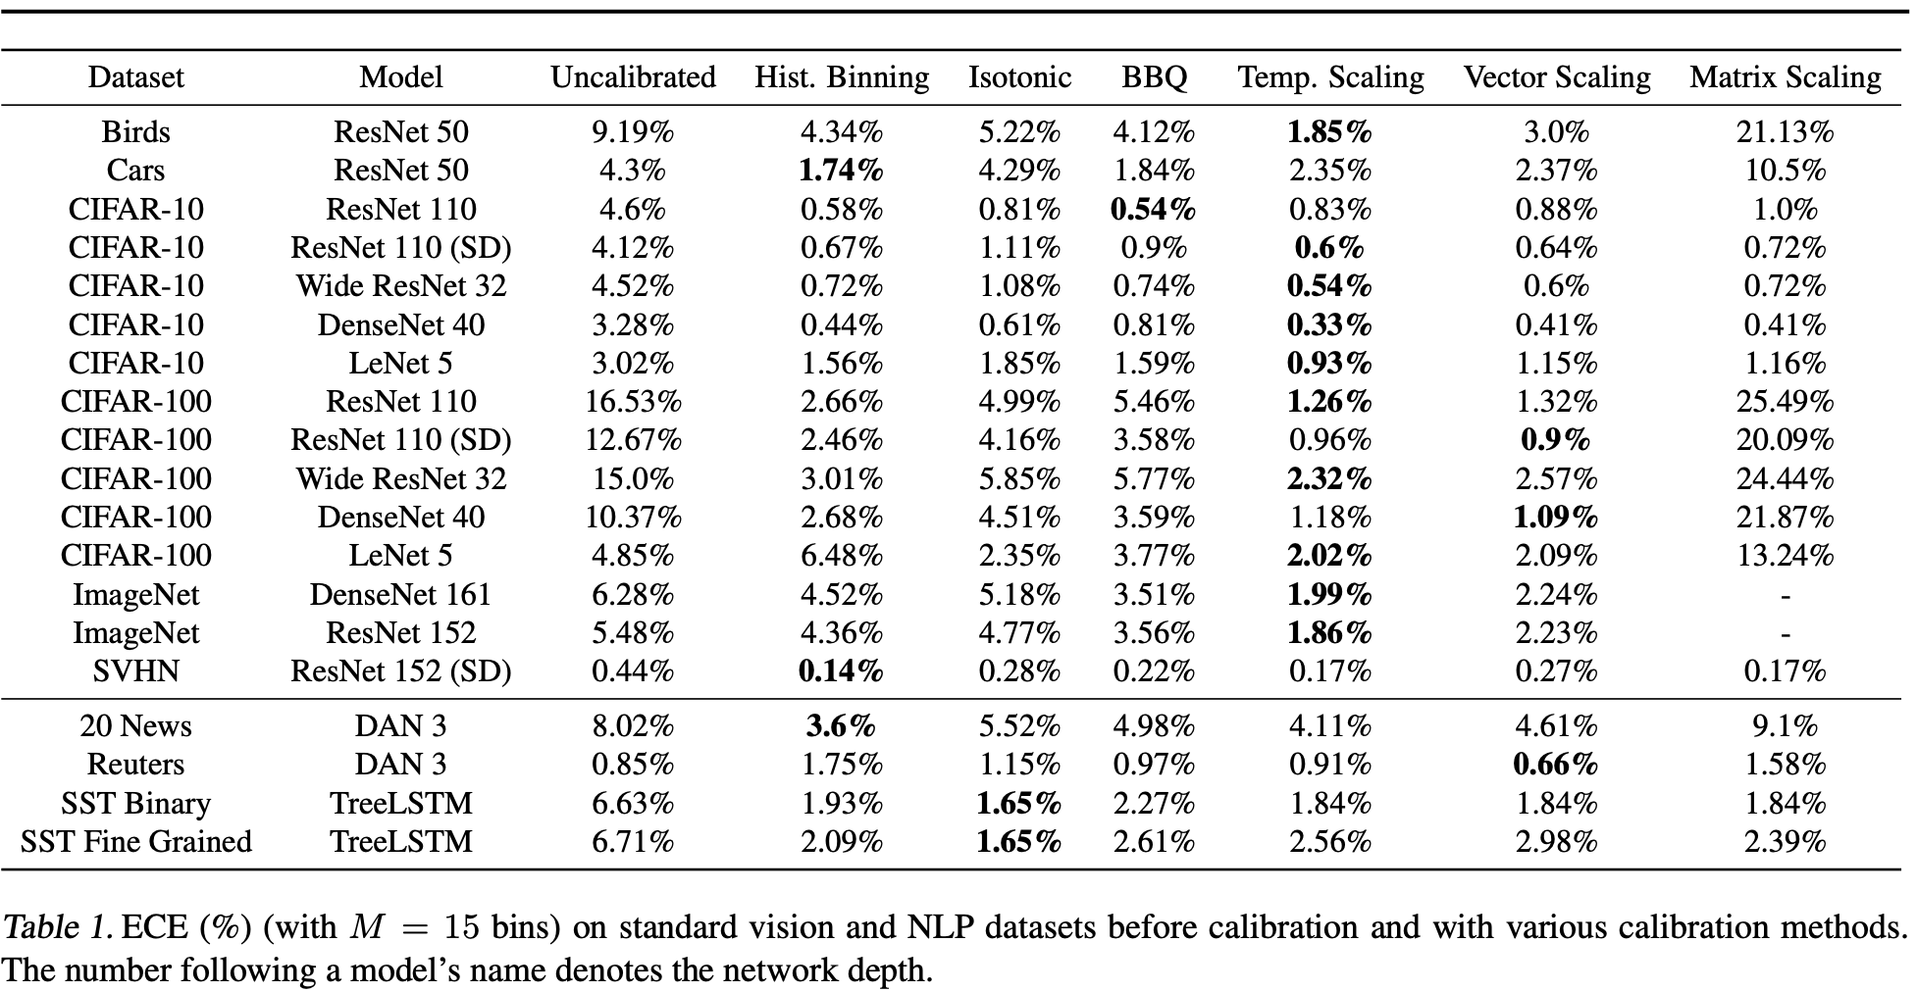
Calibration Results (ECE)
Temperature scaling outperforms the vector and matrix Platt scaling variants

Slide 25
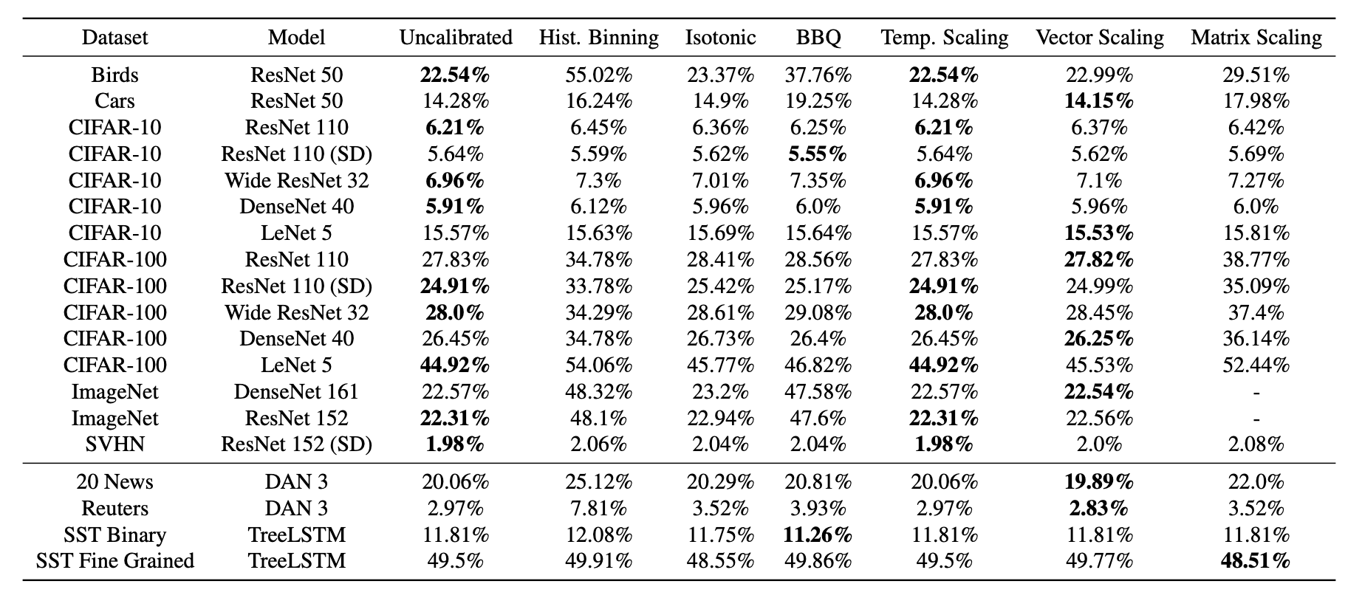
Test Error
Binning methods hurt accuracy

Slide 26
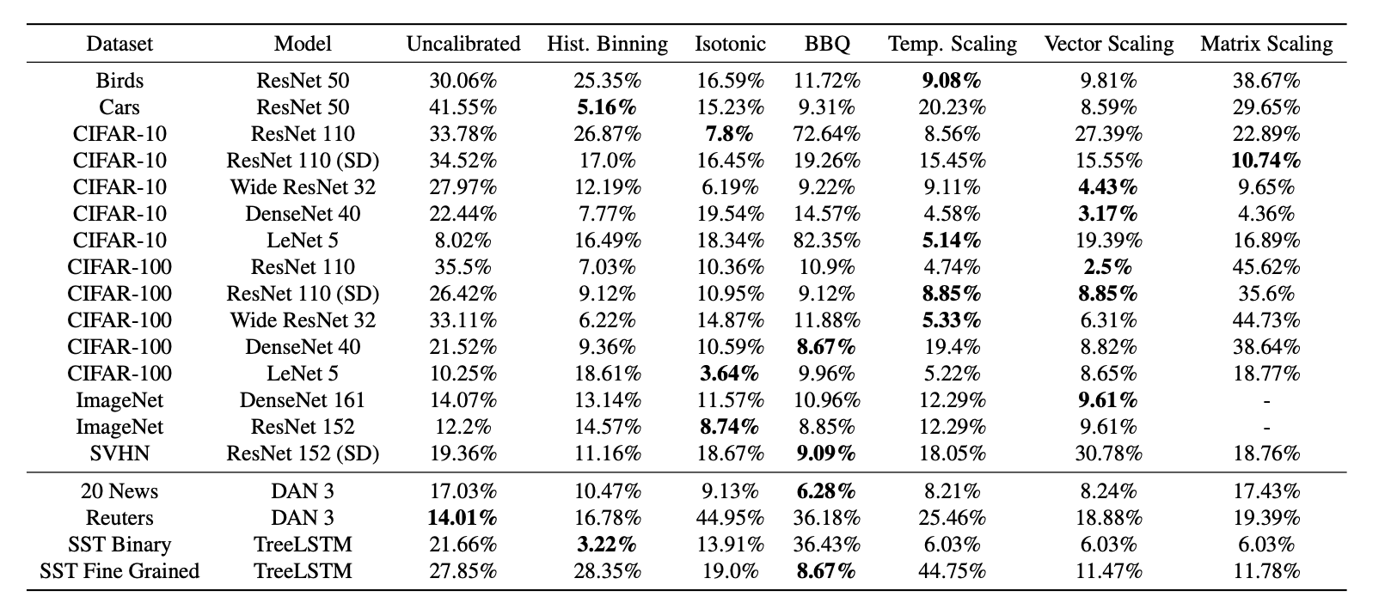
Calibration Results (MCE)

Slide 27
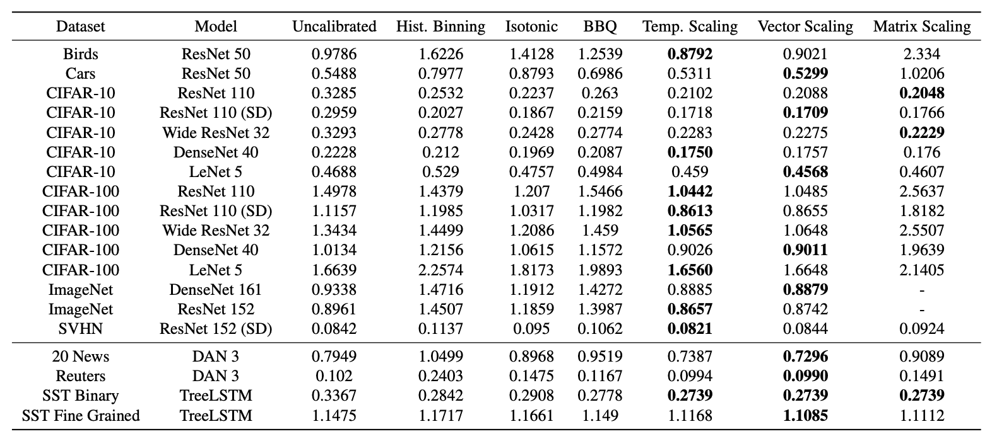
Calibration Results (NLL)

Slide 28
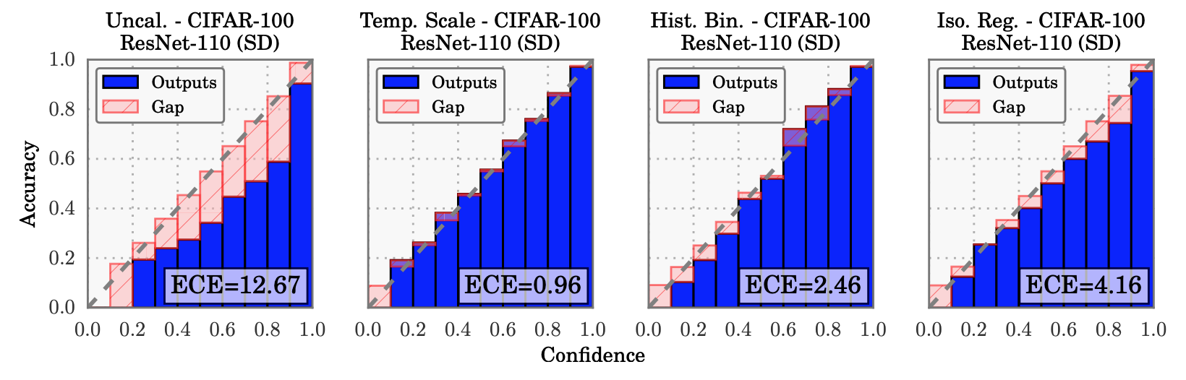
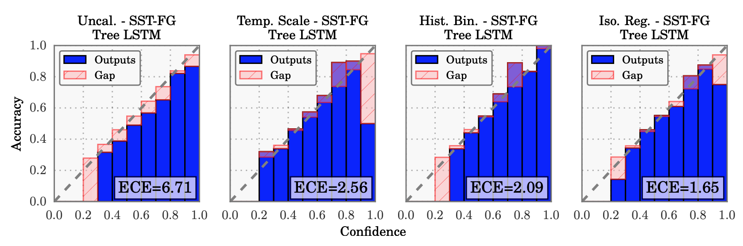
Reliability Diagrams

Slide 29
Computation Time and Implementation
Temperature scaling is easy to implement.
Compared to TS on CIFAR-100:
finding a near-optimal vector scaling solution with CGD requires 2 orders of magnitude more time.
Histogram binning and isotonic regression take an order of magnitude more time.
BBQ takes 3 orders of magnitude more time.

Slide 30
Conclusion
Modern neural networks exhibit a strange phenomenon: probabilistic error and miscalibration worsen even as classification error is reduced.
Model capacity, normalization, and regularization have significant effects on network calibration.
Temperature scaling is an easy fix.

Slide 31
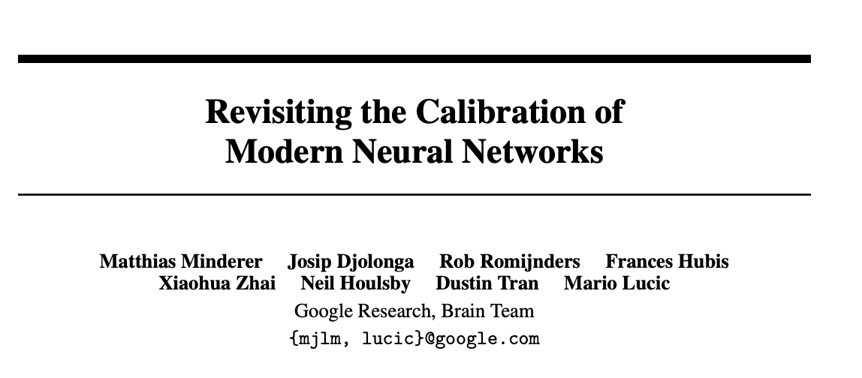

Slide 32
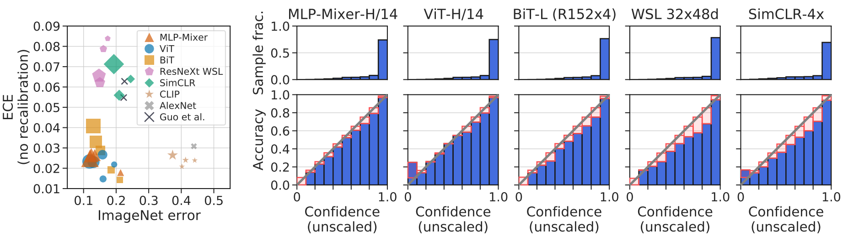
SOTA models are highly accurate & well-calibrated

Slide 33
Contents
In-Distribution Calibration
Out-of-Distribution Calibration
Relating Accuracy and Calibration
Pitfalls and Limitations

Slide 34
Experimental Setup (Model Families)
MLP-Mixer (Tolstikhin et al., 2021) is based exclusively on multi-layer perceptrons (MLPs) and is pre-trained on large supervised datasets.
ViT (Dosovitskiy et al., 2021) processes images with a transformer architecture originally designed for language (Vaswani et al., 2017) and is also pre-trained on large supervised datasets.
BiT (Kolesnikov et al., 2020) is a ResNet-based architecture (He et al., 2016). It is also pre-trained on large supervised datasets.
ResNext-WSL (Mahajan et al., 2018) is based on the ResNeXt architecture and trained with weak supervision from billions of hashtags on social media images.
SimCLR (Chen et al., 2020) is a ResNet, pretrained with an unsupervised contrastive loss.
CLIP (Radford et al., 2021) is pretrained on raw text and imagery using a contrastive loss.
AlexNet (Krizhevsky et al., 2012; Krizhevsky, 2014) was the first convolutional neural network to win the ImageNet challenge.

Slide 35
Experimental Setup (Datasets)
IMAGENET (Deng et al., 2009)
IMAGENETV2 (Recht et al., 2019) is a new IMAGENET test set collected by closely following the original IMAGENET labeling protocol.
IMAGENET-C (Hendrycks & Dietterich, 2019) consists of the images from IMAGENET, modified with synthetic perturbations such as blur, pixelation, and compression artifacts at a range of severities.
IMAGENET-R (Hendrycks et al., 2020a) contains artificial renditions of IMAGENET classes such as art, cartoons, drawings, sculptures, and others.
IMAGENET-A (Hendrycks et al., 2021) contains images that are classified as belonging to IMAGENET classes by humans, but adversarially selected to be hard to classify for a ResNet50 trained on IMAGENET.

Slide 36
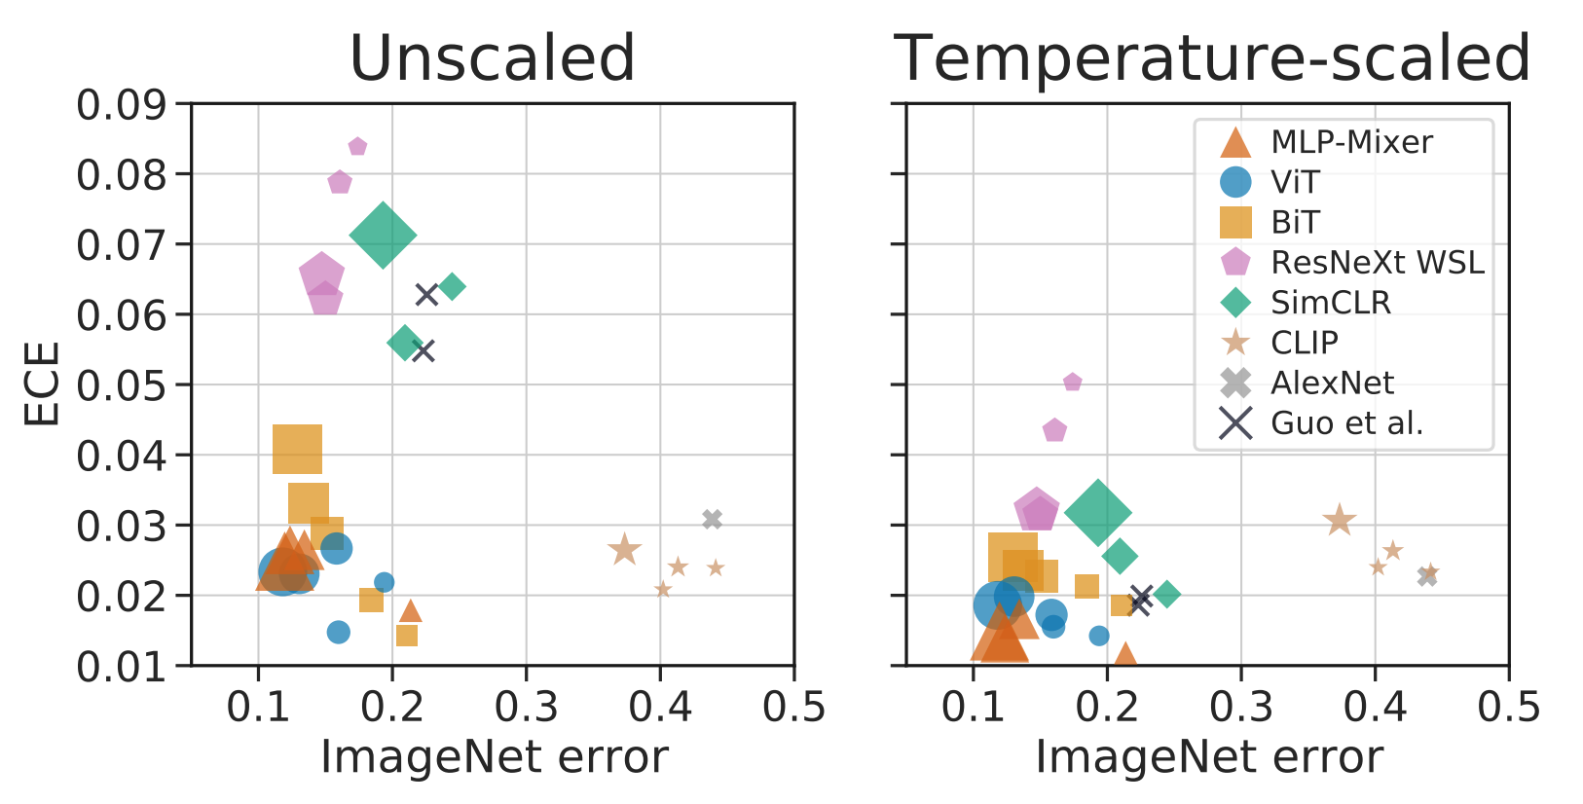
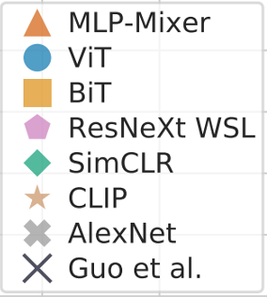
In Distribution Calibration
Recent models are both highly accurate and calibrated out-of-box

Slide 37
In Distribution Calibration
Temperature scaling reveals consistent properties of model families
Model Families occupy different Pareto Sets
Non-convolutional models : MLP mixer, ViT perform very well
In-distribution, larger models within a family are slightly worse calibrated.

Slide 38
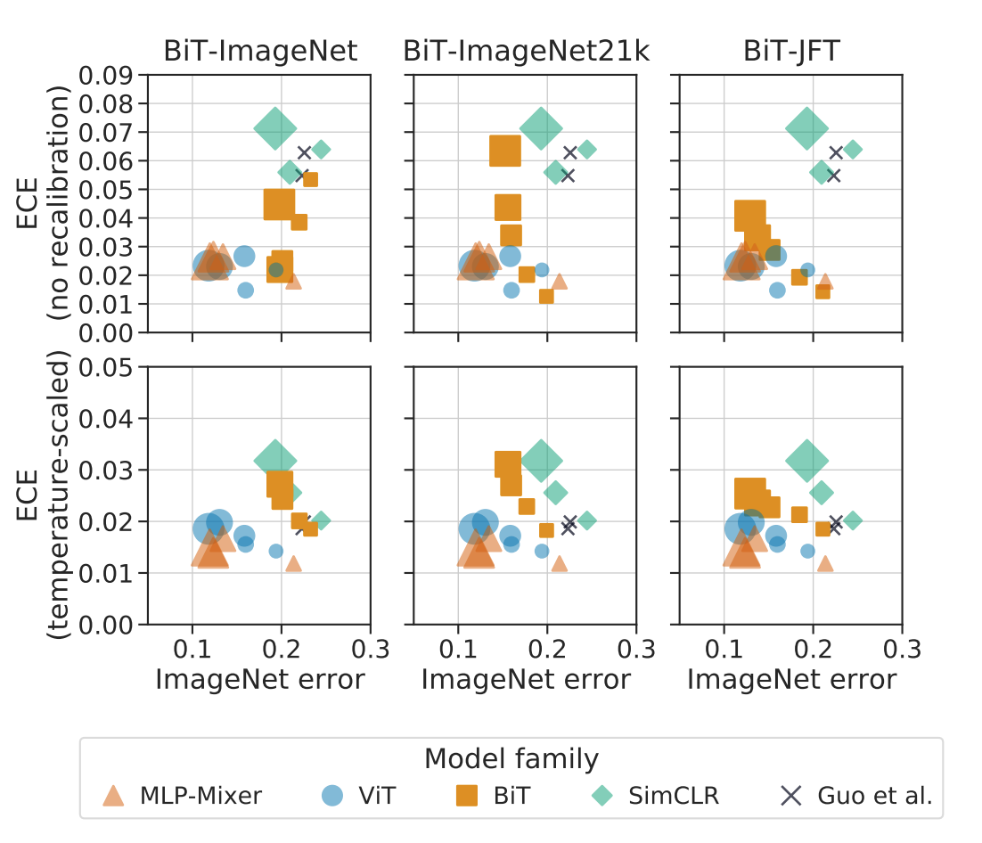
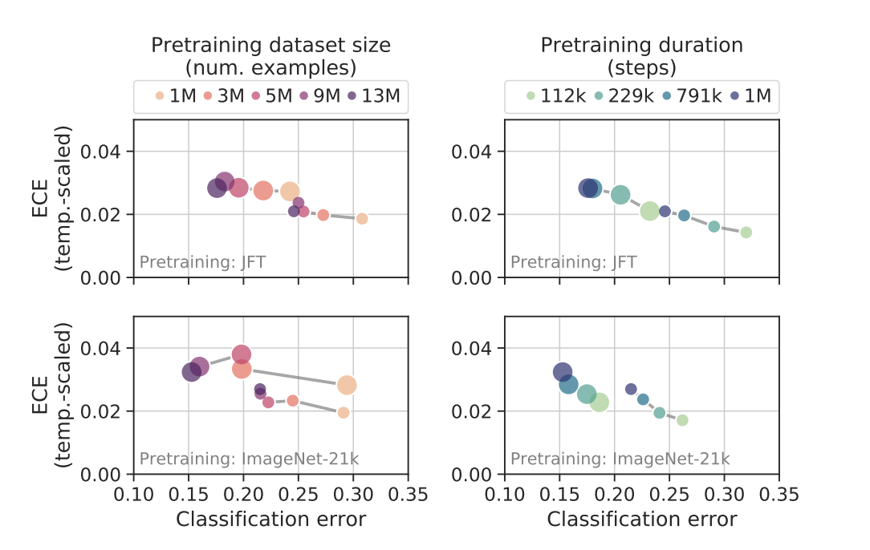
What explains model differences ?
BiT models pretrained on IMAGENET (1.3M images), IMAGENET-21K (12.8M images), or JFT-300 (300M images)
More pretraining improves accuracy but not ECE.
Architecture’s Inductive Bias plays an important role.

Slide 39

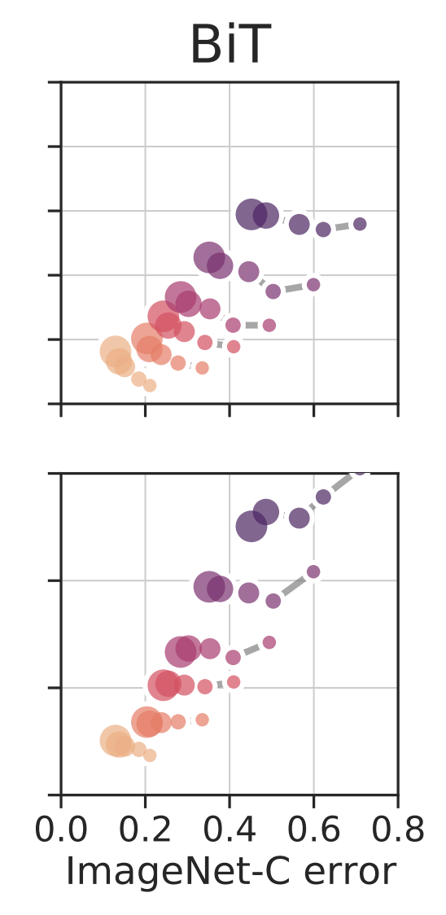
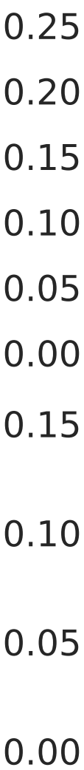
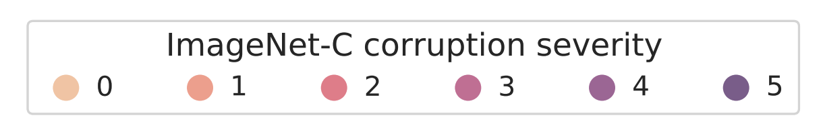
Out-of-Distribution Calibration
ImageNet-C
Both classification error and calibration error increases under distribution shift.
Larger models tend to be more robust to distribution shift.

Slide 40
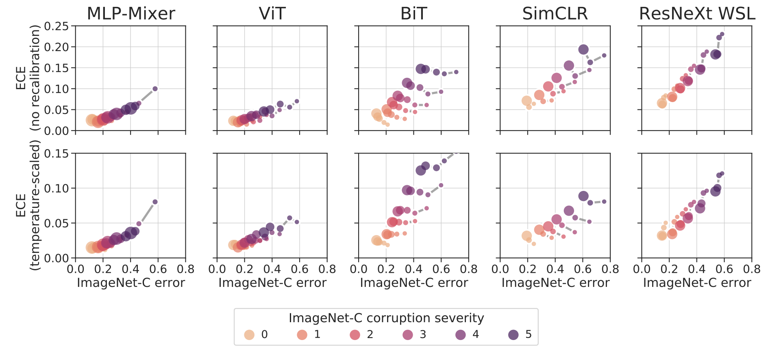
Slower degradation for MLP-Mixer, ViT
Calibration of larger models is more robust to distribution shift.

Slide 41
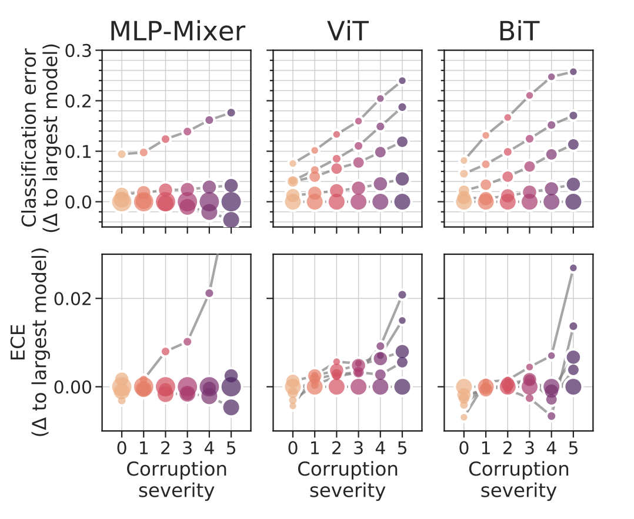
Errors tend to increase slowly for larger models.
Changes in ECE are smaller.

Slide 42

Natural Out-of-Distribution Benchmarks
Larger and more accurate models maintains good calibration o.o.d.
Strong accuracy and calibration in-domain translates to o.o.d.

Slide 43
Trade off between Accuracy and Calibration
Preference between model families.
Within families there is an accuracy-calibration tradeoff.

Slide 44


Correlation between accuracy and calibration
ECE as a function of accuracy for various model families ($y=ax^{k}$)

Slide 45

Which one should a practitioner choose?
Expected cost for two BiT variants, one with better classification error (R152x4, by 0.08), and one with better ECE (R50x1, by 0.009).

Slide 46

Similar trend for comparing different models from the same family (a-f), different amount of pretraining steps (g-h) and similar classification error and ECE difference.

Slide 47

Effect of Label Smoothing

Slide 48



Other measures of calibration.

Slide 49

Limitations and Pitfalls
Effects of number of bins in ECE.
BiT ResNet models differ in model size, pretraining dataset size and duration.

Slide 50
Conclusion
Recent models (eg: Vision Transformers) are well calibrated compared to past models (eg: ResNet) and their performance is more robust to distribution shift.
In-distribution calibration slightly deteriorates with increasing model size, but this is outweighed by a simultaneous improvement in accuracy.
Under distribution shift, calibration improves with model size, reversing the trend seen in-distribution.
Model size, pretraining duration, and pretraining dataset size cannot fully explain differences in calibration properties between model families and this requires further investigation.

Slide 51
Thanks! Questions?

Slide 52

Issues with Calibration Metrics

Slide 53
Issues with Calibration Metrics
Not Computing Calibration Across All Predictions
Fixed Calibration Ranges
Bias-Variance Tradeoff
Pathologies in Static Binning Schemes

Slide 54

Class-Wise Calibration.

Slide 55



Static Calibration Error: extension to every probability beyond max probability
Adaptive Calibration Error (ACE). uses an adaptive scheme which spaces the bin intervals so that each contains an equal number of predictions.
acc(r, k) and conf(r, k) are the accuracy and confidence of adaptive calibration range r for class label k, respectively.
Calibration range $r$ defined by the $N/R$^{th} index of the sorted predictions.
Other kinds of norms, and thresholding.

Slide 56


Experiments
ECE, SCE, and ACE (with 15 bins) on a ResNet-110 applied to CIFAR-100 before calibration, and after the application of post-processing methods.
ECE, SCE, and ACE (with 15 bins) on a ResNet-50 applied to ImageNet before calibration, and after the application of post-processing methods.
The best recalibration method depends on the metric.

Slide 57

Calibration under Label Noise

